Slide 1
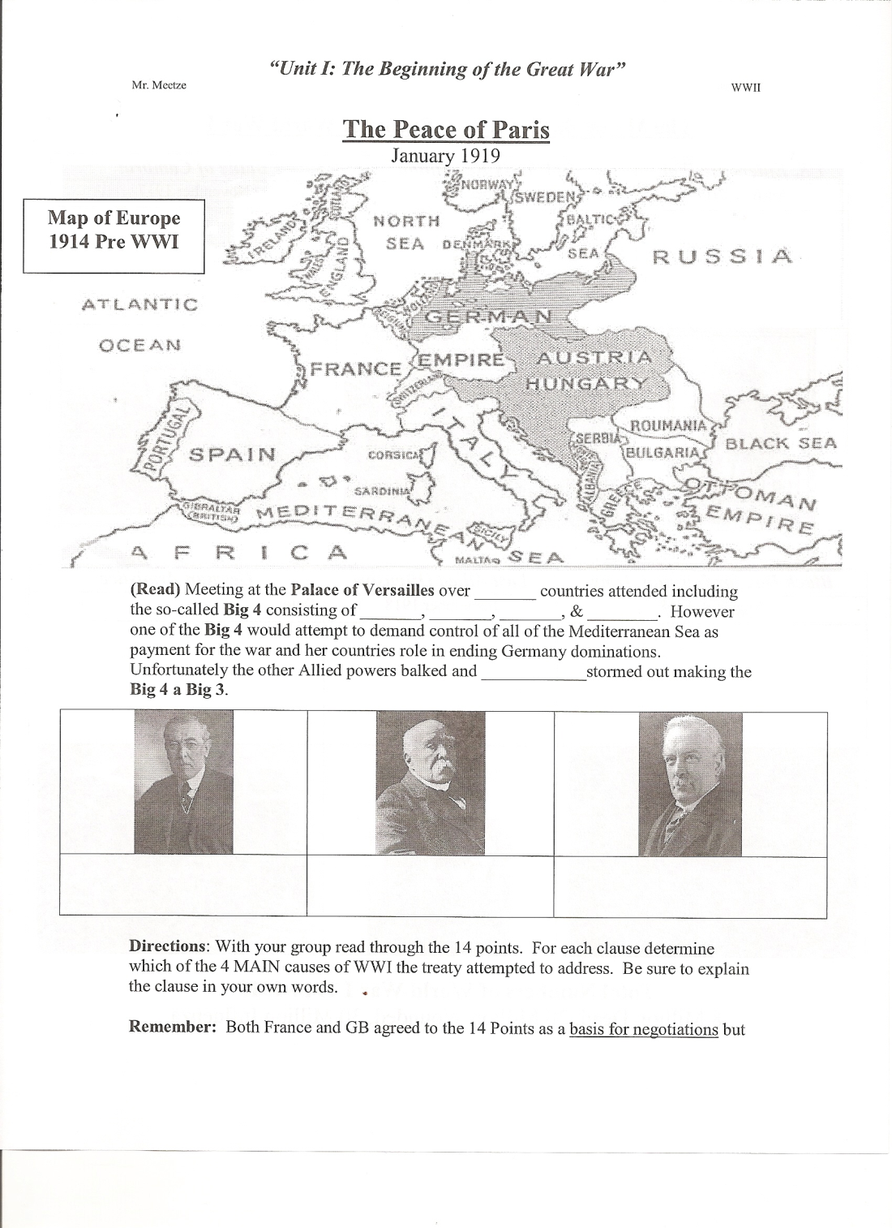
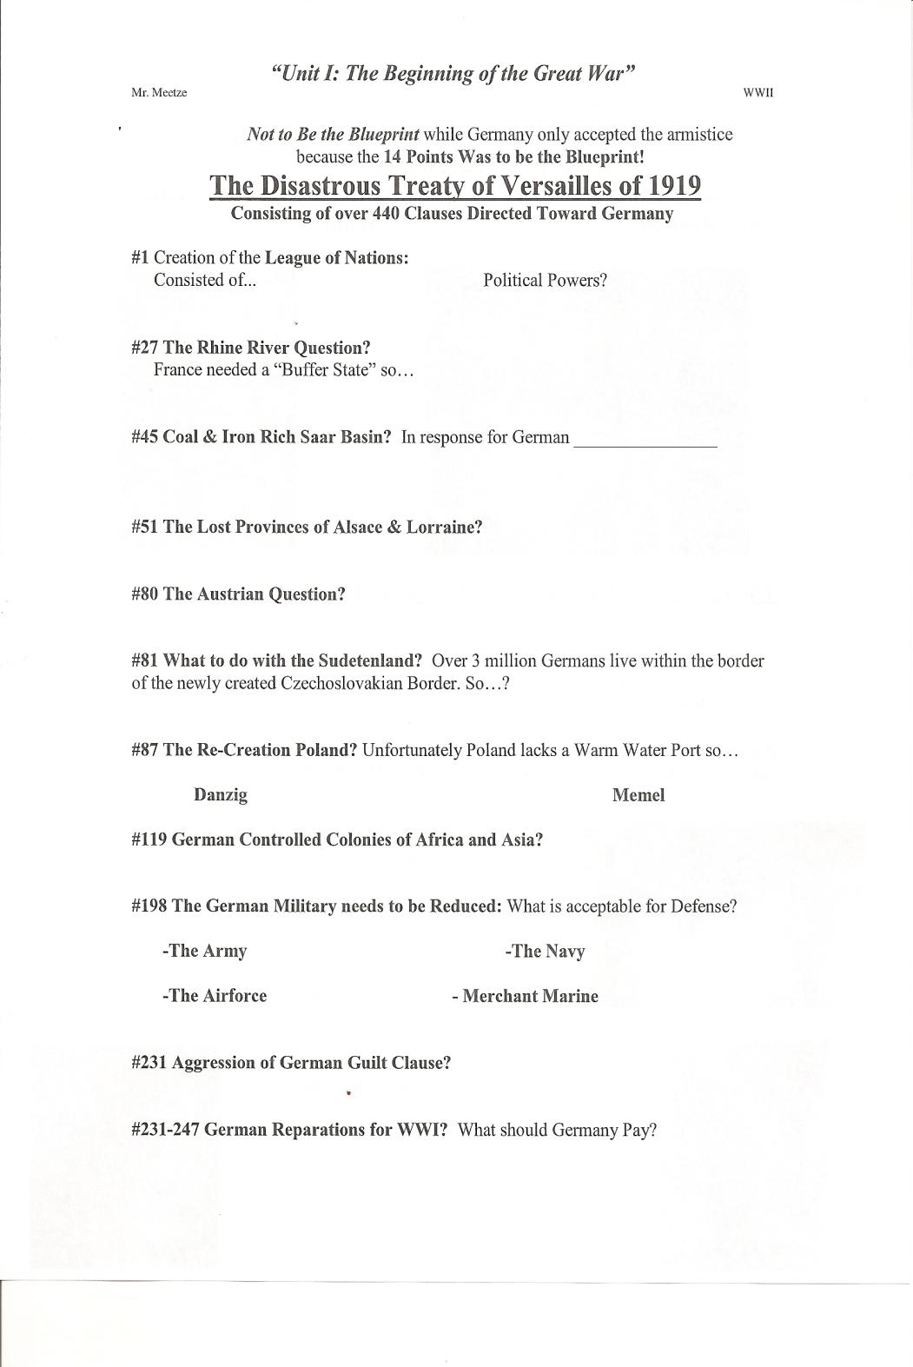

Slide 2
Peace of Paris January 1919
(Read) Meeting at the Palace of Versailles over _______ countries attended including the so-called Big 4 consisting of_____________.
However one of the Big 4 would attempt to demand control of all of the Mediterranean Sea as payment for the war and her countries role in ending Germany dominations. Unfortunately the other Allied powers balked and ____________stormed out making the Big 4 a Big 3
31
I, B, F, US
Italy

Slide 3
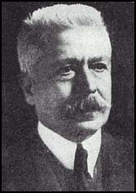
Your OUT!!!!!!!!!!!!!
All of the Mediterranean
Yeah that’s Optimistic
Vittorio Orlando
“The Optimist”

Slide 4
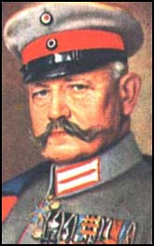
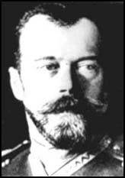
YOUR OUT!!!!!!!!!!!!
Czar Nicholas II
“Need Land, Peace, Bread”
Paul von Hindenburg
“New Iron Chancellor”

Slide 5
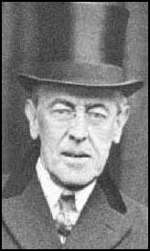
WWI Leaders from 1916-1917
President Woodrow Wilson “The Idealist”

Slide 6
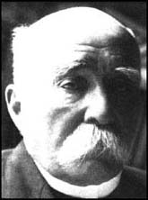
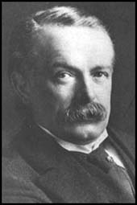
WWI Leaders from 1916-1917
Premier Georges Clemenceau
“The Tiger”
Prime Minister David Lloyd George
“The Peacemaker”

Slide 7
President Wilson’s 14 Points January 8 1918
The address was intended to assure the country that the Great War was being fought for a moral cause and for postwar peace in Europe.
People in Europe generally welcomed Wilson's intervention, but his Allied colleagues Georges Clemenceau, David Lloyd George and Vittorio Emanuele Orlando were skeptical of the applicability of Wilsonian idealism.
Directions: With your group read through the 14 points. For each clause determine which of the 4 MAIN causes of WWI the treaty attempted to address. Be sure to explain the clause in your own words.

Slide 8
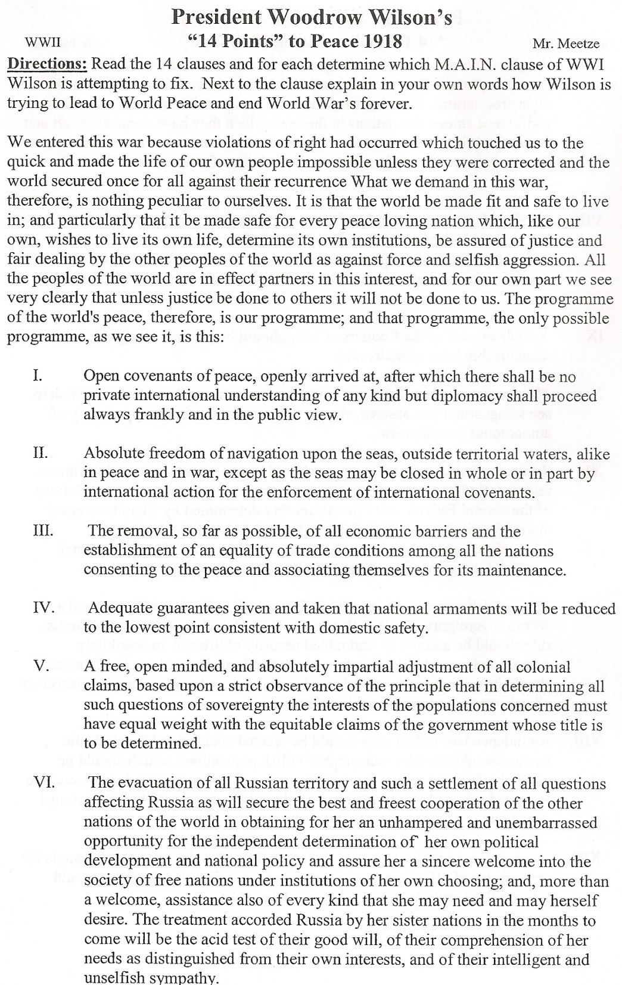
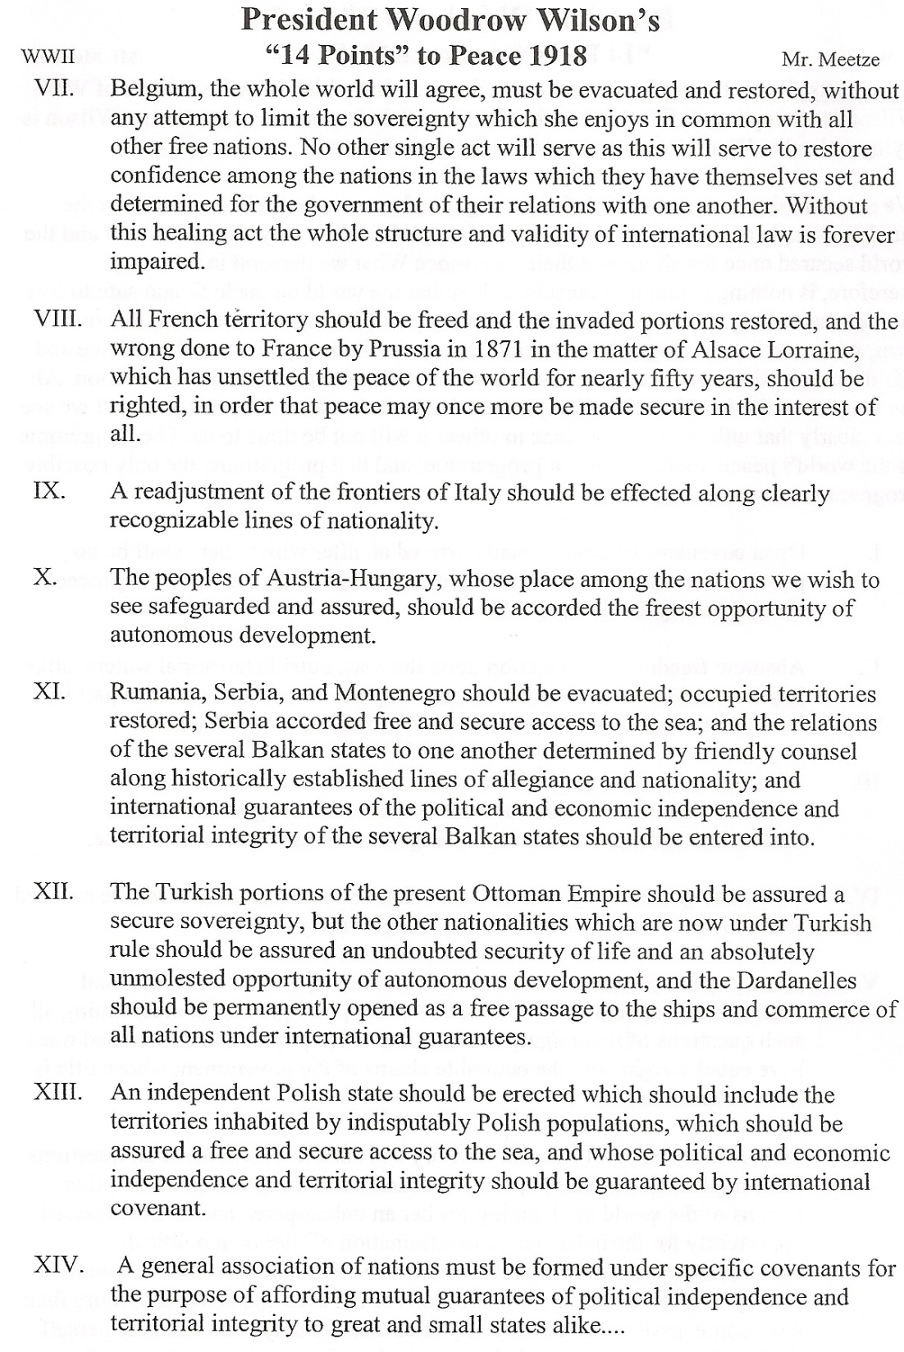

Slide 9
President Wilson’s 14 Points January 8 1918
Remember:
Germany only accepted the armistice because the 14 Points Was The Blueprint!!
Both France and GB agreed to the 14 Points as a basis for negotiations but Not to Be the Blueprint!!!!

Slide 10
The Treaty of Versailles Activity
The Treaty of Versailles was one of the peace treaties at the end of World War I. It ended the state of war between Germany and the Allied Powers. It was signed on June 28, 1919, exactly five years after the assassination of Archduke Franz Ferdinand.
Part I: Number Your Self 1-3
#1 Wilson /America
#2 Clemenceau /France
#3 Lloyd George / Great Britain
Read Your Directions for Your Character in the Versailles Packet.
Upon Completion Read the Clauses and according to your guide circle the answer Your Character would choose

Slide 11
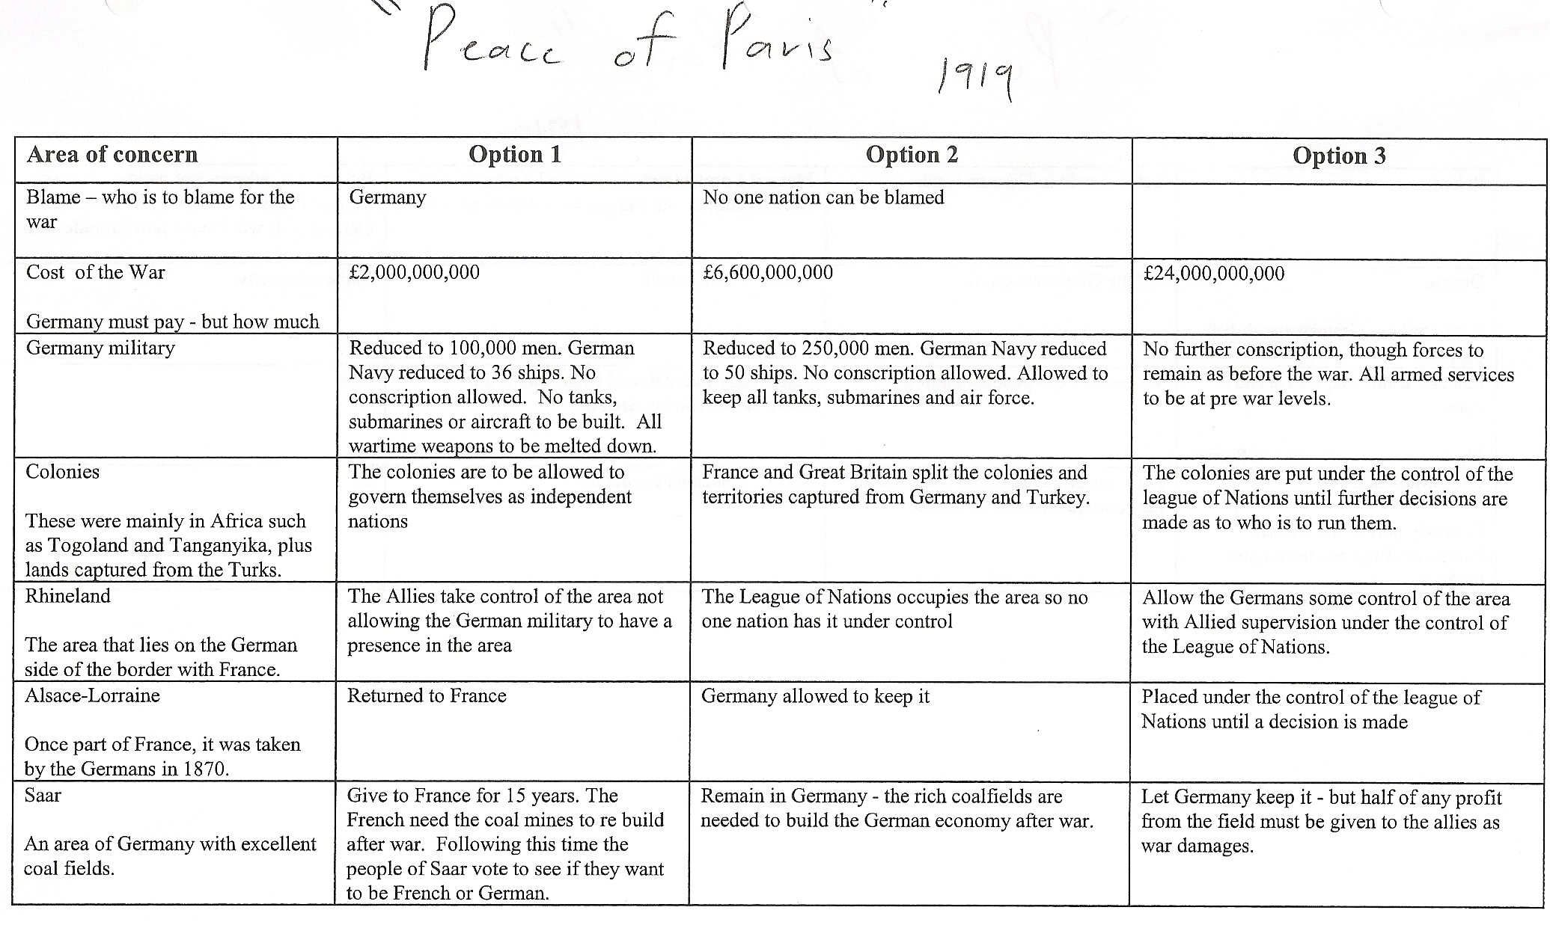

Slide 12
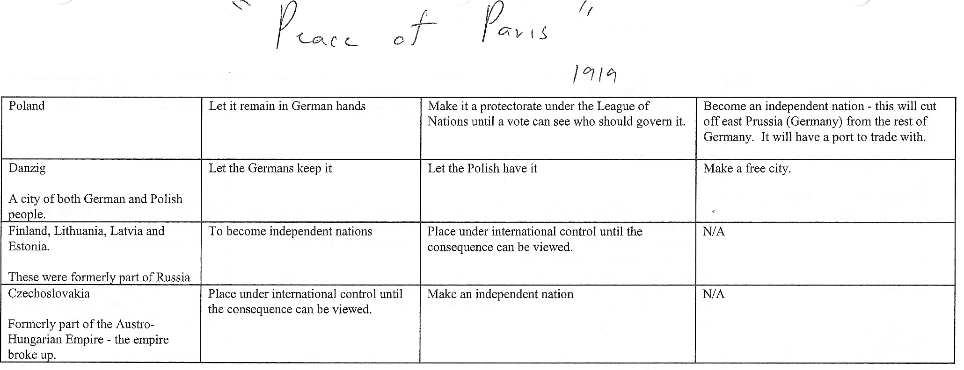

Slide 13
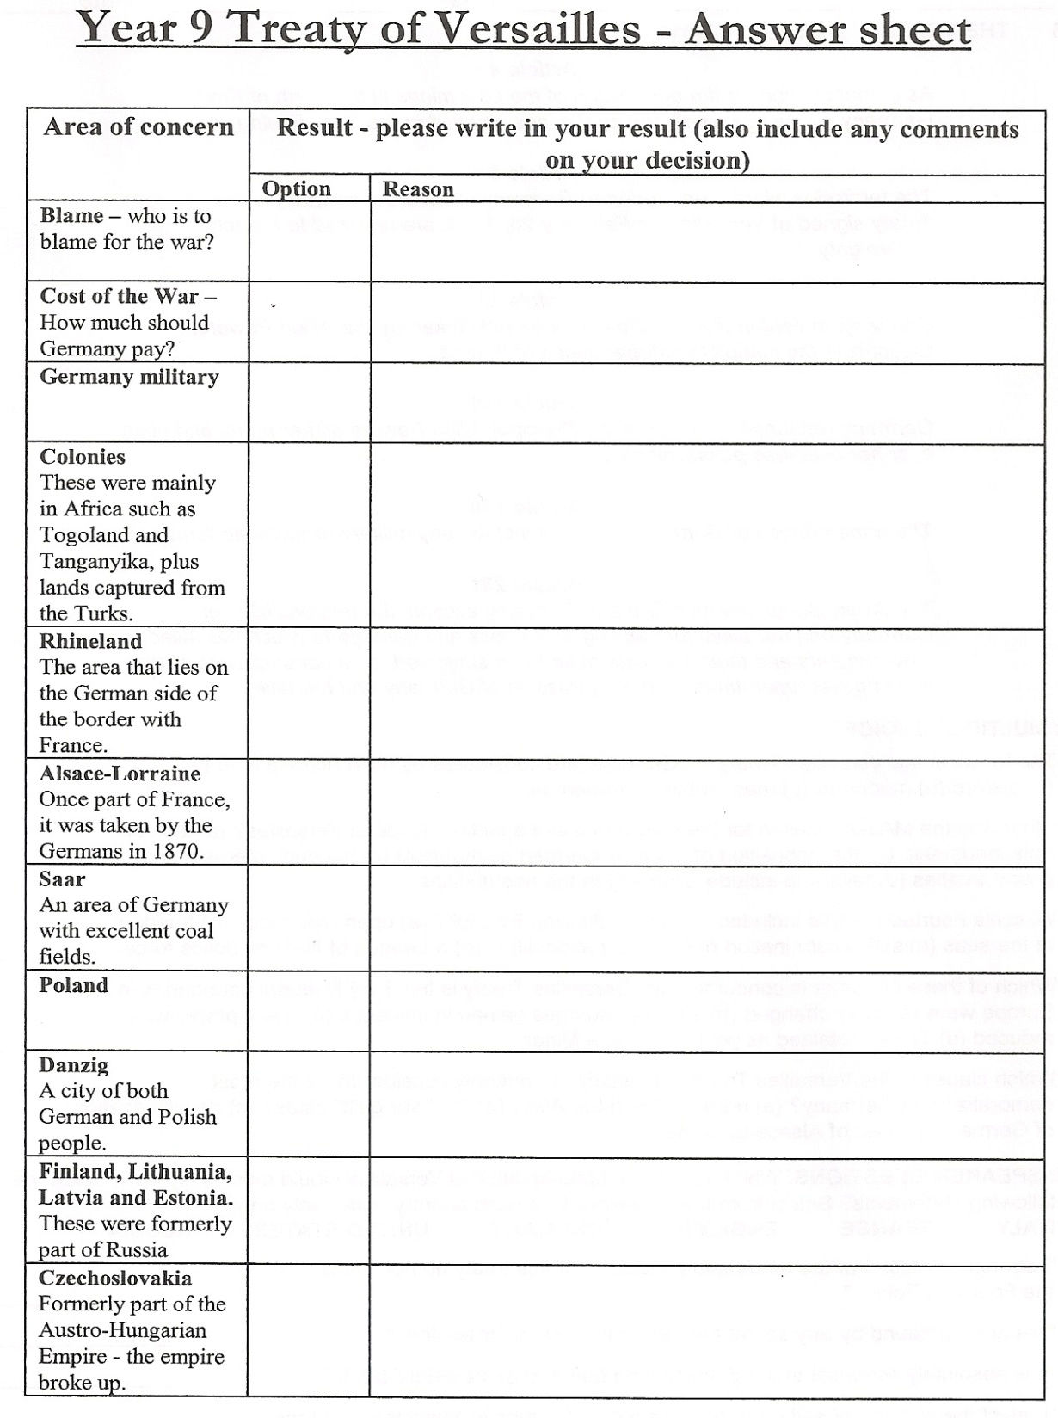
Treaty of Versailles Activity
Directions: Your Group will have 10 Minutes to determine your decision to the 11 clauses.
All Members Must Agree and Present a Unified Front.
Within your Group Determine one person will Read outloud the Area of Concern. Each member will explain WHY they choose what they did.
Majority Rules!! Fill in The Reason Why on the Chart

Slide 14
The Treaty of Versailles
The Treaty of Versailles was one of the peace treaties at the end of World War I. It ended the state of war between Germany and the Allied Powers. It was signed on June 28, 1919, exactly five years after the assassination of Archduke Franz Ferdinand.
Consisting of 440 Clauses and printing out at 197 pages the treaty covered anything and everything including…

Slide 15
The Treaty of Versailles Article 244 Annex 6
As an immediate advance on account of the animals referred to in paragraph 2 (a) above, Germany undertakes to deliver in equal monthly installments in the three months following the coming into force of the present Treaty the following quantities of live stock:
(1) To the French Government.
500 stallions (3 to 7 years);
30,000 fillies and mares (18 months to 7 years), type: Ardennais, Boulonnais or Belgian; 2,000 bulls (18 months to 3 years);
90,000 milch cows (2 to 6 years);
1,000 rams;
100,000 sheep; ??????
10,000 goats.
(2) To the Belgian Government.
200 stallions (3 to 7 years), large Belgian type;
5,000 mares (3 to 7 years), large Belgian type;
5,000 fillies (18 months to 3 years), large Belgian type;
2,000 bulls (18 months to 3 years);
50,000 milch cows (2 to 6 years);
40,000 heifers;
200 rams;
20,000 Sheep;
5,000 sows.
The animals delivered shall be of average health and condition. To the extent that animals so delivered cannot be identified as animals taken away or seized, the value of such animals shall be credited against the reparation obligations of Germany in accordance with paragraph 5 of this Annex.

Slide 16
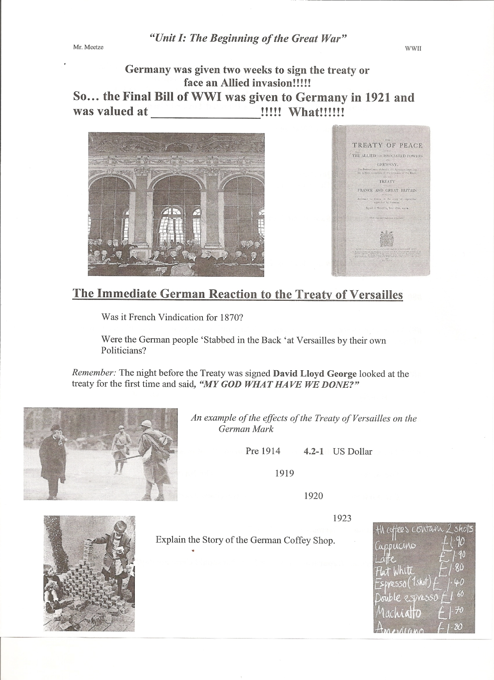
Choose & Star 4 of the 8 Clauses that You will Memorize for your Essay on the Unit I & II Test
Everyone Will Memorize 198, 231-247

Slide 17
The Treaty of Versailles
#1 League of Nations
Could use economic sanctions but could not use military force to settle problems plus No Germany, Russia, Japan, or USA.
#27 The Rhine River Question
Created a “Buffer State” between France in order to divide Germany

Slide 18
The Treaty of Versailles
#45 Saar Basin
Given to France in response for Scorched Earth Policy to French coal mines. Contains both ____ & ____ but is located in ____???????
#51 Alsace & Lorraine
The So-Called ‘Lost French Provinces’ of 1870 Franco Prussian War and another Buffer located near the Rhine.

Slide 19
The Treaty of Versailles
#80 The Austrian Question?
100% of Austria speaks German but not allowed to be German? Why???
#81 What to do with the Sudetenland?
3 million Germans located in this area will now become Czechoslovakian. Huh?

Slide 20
The Treaty of Versailles
#87 Polish Question
Re created but divided East Prussia (Germany in ½). In addition created the countries of Latvia, Lithuania, and Estonia on the Baltic Sea.
Ports of Danzig (German but now Polish Port) Memel (Germ now Lithuania)
#119 German Colonies
Given to the League of Nations. The Reality? Great Britain & France will now control more of Africa & Japan Asia

Slide 21
The Treaty of Versailles
#198 German Military
Army Limited to 100,000 men & 4000 Officers who must serve for 12-18 years
Navy Limited to 15,000 consisting of 6 total Ships.
No Air-force, Submarines, Conscription or the _____, and Heavy Artillery
Entire Merchant Marine or Trade Ships sent to Great Britain in response to German _____ _____ _____

Slide 22
The Treaty of Versailles
#231 Aggression of Guilt or the “War Guilt Clause”
Necessary for Allies to imply German Guilt of Aggression. Why?
#231-247 Reparations
Both Great Britain & France need reparations. So the allies set up a Commission to determine the cost of WWI.
Germany paid $5 Billion up front until the final bill was determined..
Final Bill in 1921 was $ 33 Billion in Gold or $500 million in Gold for the next 66 years!!!!!!!!!

Slide 23
German Reaction to the Treaty of Versailles
Was it French Vindication for 1870?
Were the German people ‘Stabbed in the Back’?
Germany was given two weeks to sign the treaty or face an allied invasion!!!!!
Remember: The night before the Treaty was signed David Lloyd George looked at the treaty for the first time and said, “MY GOD WHAT HAVE WE DONE?”

Slide 24
Effects of the Treaty of Versailles
An example of the effects of the Treaty of Versailles on the German Mark
Pre 1914 4.2-1 US Dollar
1919 9-1
1920 65-1
1923 18,000-1
Explain the Story of the German Coffey Shop.
Brainstorm 3 other effects

Slide 25
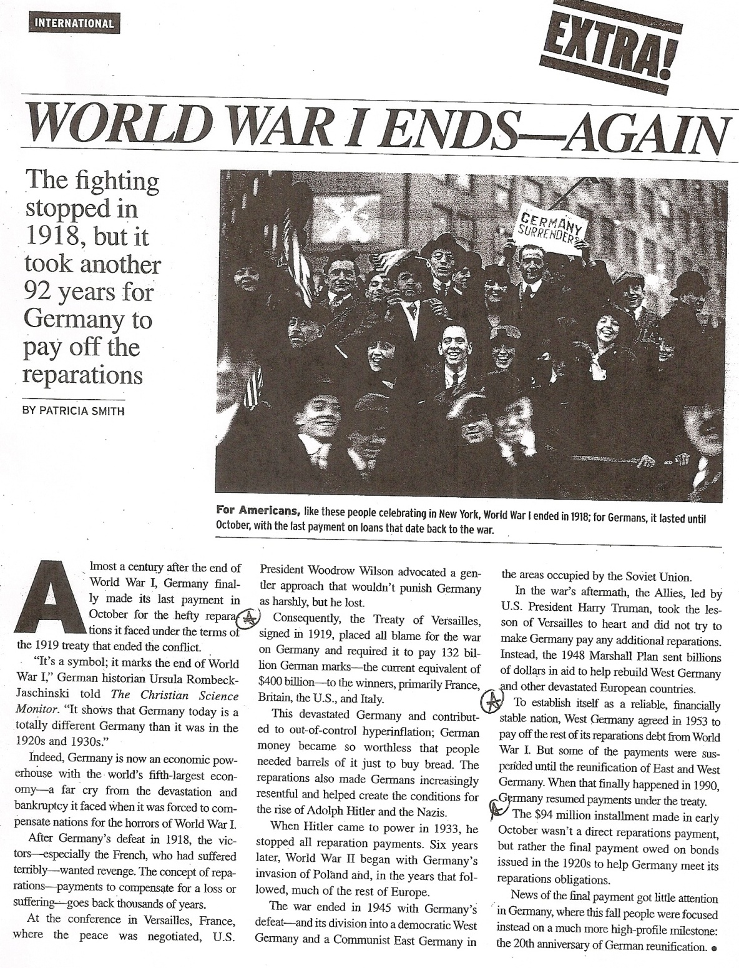

Slide 26
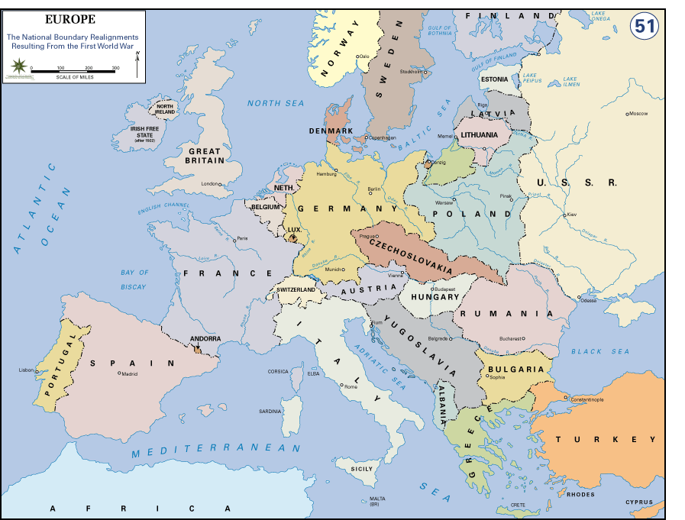

Slide 27
Quiz: Treaty of Versailles

Slide 28
2 pts each

